Slide 1



Stroke Prediction
Celia, Mounika, Sharon

Slide 2
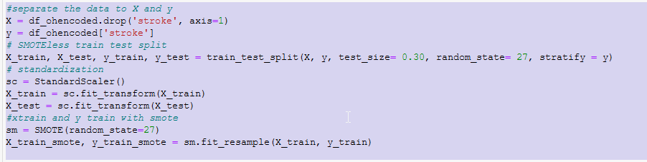
Setting up the Data
Separate
Train Test Split
Standardization
Smote
Recall: Focusing on Recall as the metric we want to improve. It is the measure of our model correctly identifying ‘True Positives’.
Recall = TP/(TP+ FN)

Slide 3
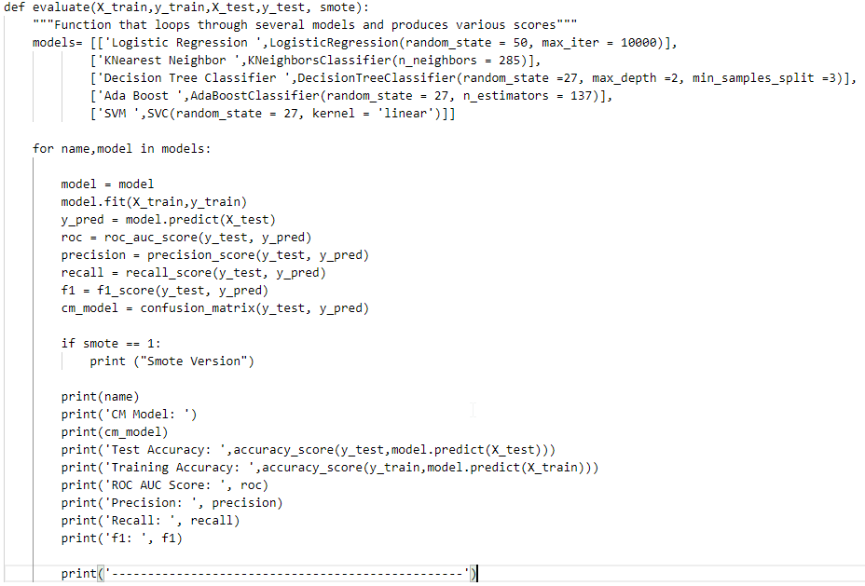

Slide 4


Running the function against our non-SMOTE data and our SMOTE data

Slide 5
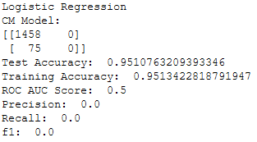
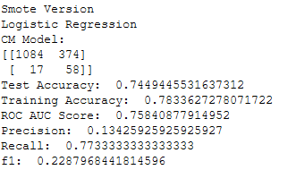
Logistic Regression
Non SMOTE
SMOTE
No predicted samples. Recall is 0

Slide 6
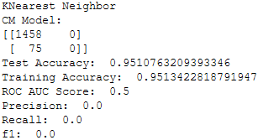
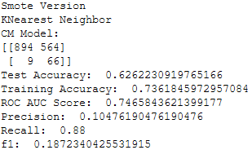
K Nearest Neighbor
Non SMOTE
SMOTE
No predicted samples. Recall is 0

Slide 7
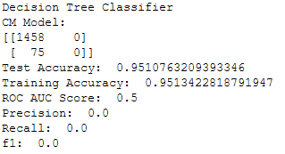
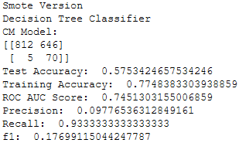
Decision Tree Classifier
Non SMOTE
SMOTE
No predicted samples. Recall is 0

Slide 8
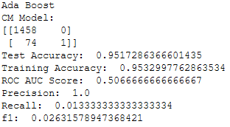
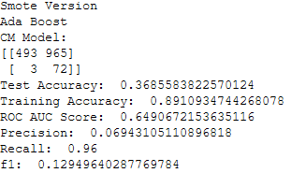
AdaBoost Classifier
Non SMOTE
SMOTE
Best Recall

Slide 9
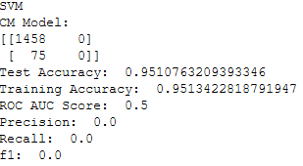
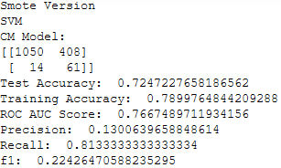
SVM
Non SMOTE
SMOTE
No predicted samples. Recall is 0

Slide 10
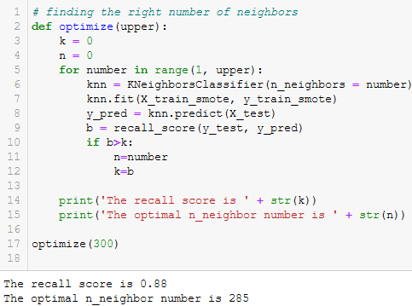
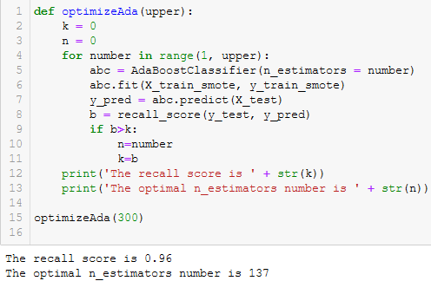
Tuning the models

